Slide 1

Air BNB Hotel Booking
Santhosh kumar s
[INTERNSHIP_17546440516895be537820f ]

Slide 2

PROBLEM STATEMENT
Analytical tone:
A comprehensive data analysis can reveal valuable insights into seasonal demand, customer behavior, and market performance, enabling smarter business strategies.
2. Professional project tone:
Leveraging data analytics helps transform raw booking information into actionable insights that enhance competitiveness and operational efficiency.
3. Concise version:
Through data analysis, hosts can make evidence-based decisions that improve profitability and guest satisfaction.

Slide 3
Project Description
Professional and concise:
The goal is to transform raw data into meaningful insights that enhance understanding of market dynamics and guide data-driven strategies in the short-term rental industry.
Project-report style:
Ultimately, the EDA will help identify opportunities for revenue optimization, highlight guest preferences, and support informed policy formulation for sustainable short-term rental growth.
Analytical and academic:
This analysis aims to uncover hidden relationships within the dataset, providing a comprehensive overview of factors influencing Airbnb performance across different regions and property segments.

Slide 4

WHO ARE THE END USERS?
Hosts & Property Managers: Gain insights to optimize pricing strategies, select competitive amenities, and improve occupancy rates.
Guests / Travelers: Make informed booking decisions by understanding pricing trends, property ratings, and neighborhood characteristics.
Tourism Boards / Policymakers: Analyze regional tourism patterns and assess the impact of short-term rentals on local communities.
Data Analysts / Researchers: Explore hospitality industry trends, customer preferences, and factors influencing booking behavior.

Slide 5

Technology Used
Programming & Analysis: Python (Pandas, NumPy, Matplotlib, Seaborn)
Development Environment: Jupyter Notebook, Google Colab
AI Tools:
ChatGPT – Used for research assistance, documentation, and report preparation
Julius AI – Used for automated exploratory data analysis and visualization insights
Data Source: Public Airbnb Open Dataset (CSV format)
Visualization & Reporting: Matplotlib, Seaborn, and PowerPoint (PPT) for presentation and communication of results

Slide 6
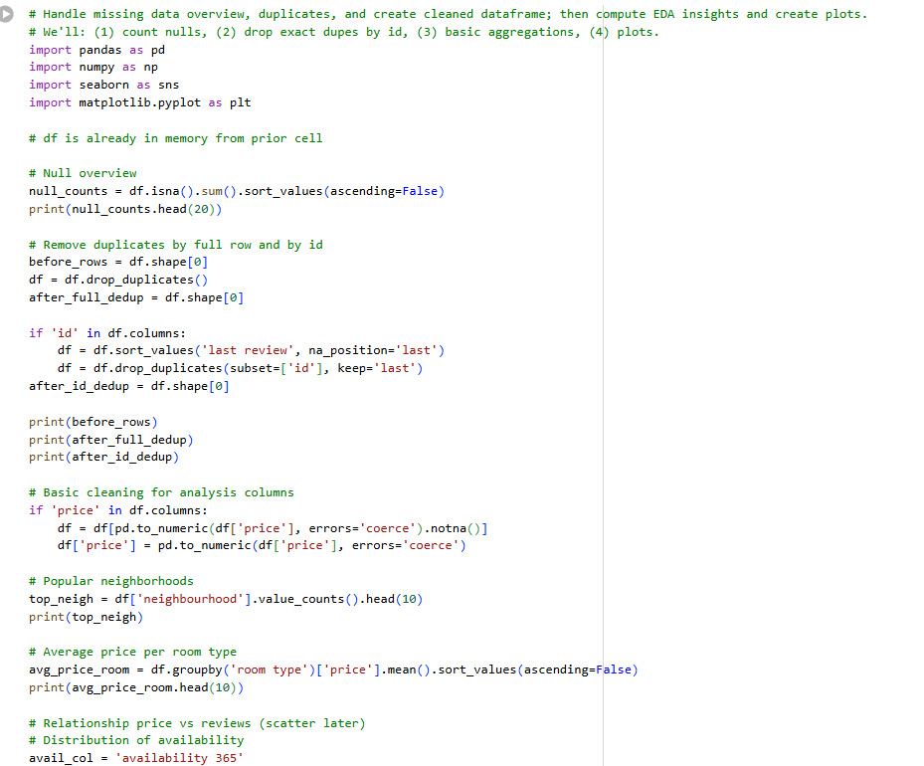
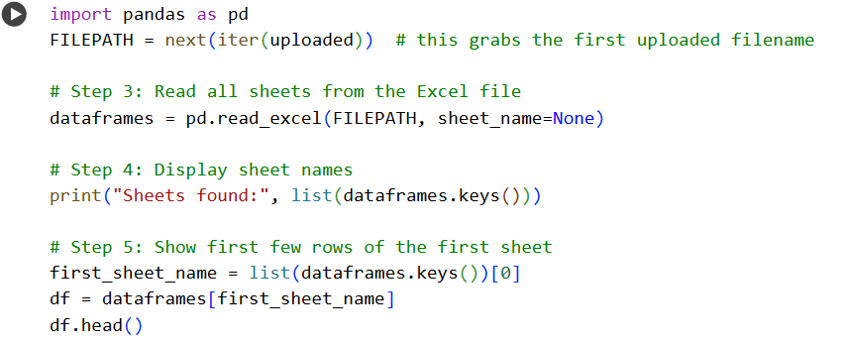
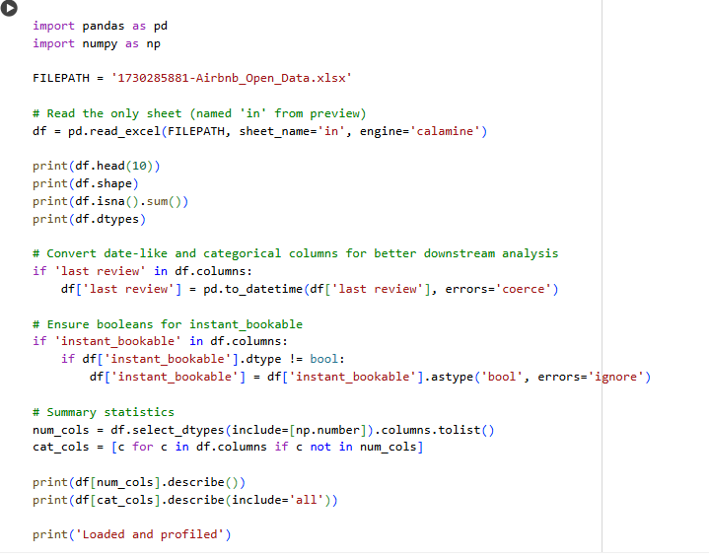
Python Code

Slide 7
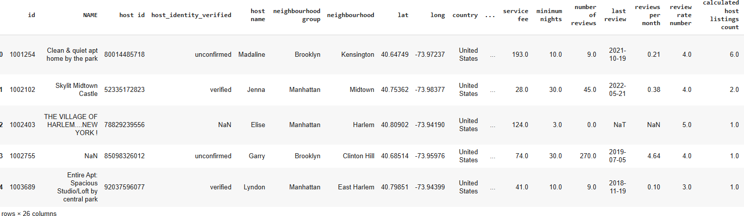
RESULTS1
VOIS_AICTE_OCT2025_SANTHOSH_KUMAR_S.ipynb-COLAB

Slide 8
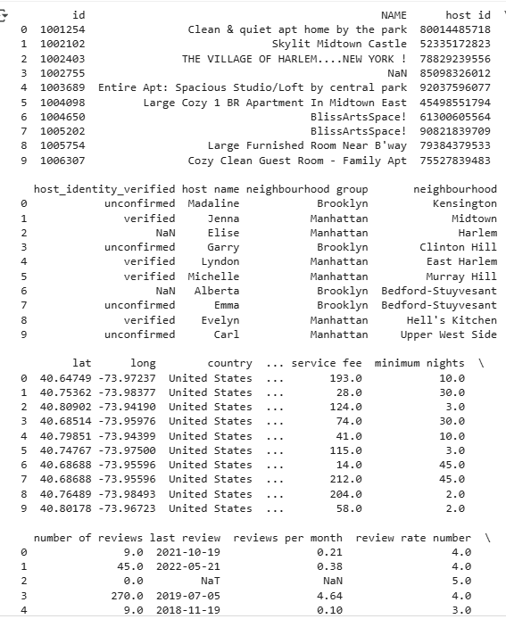
RESULTS2
VOIS_AICTE_OCT2025_SANTHOSH_KUMAR_S.ipynb-COLAB

Slide 9
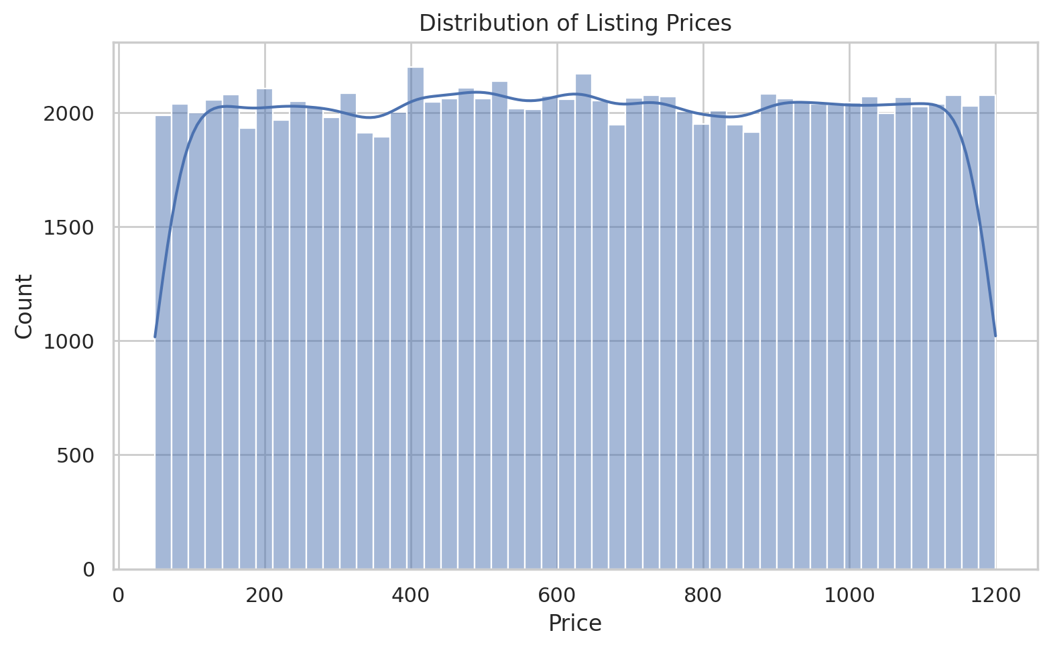
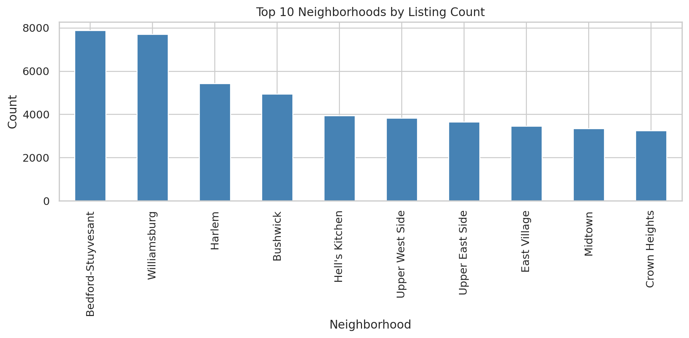
RESULTS3
VOIS_AICTE_OCT2025_SANTHOSH_KUMAR_S.ipynb-COLAB

Slide 10
GitHub repository
SANTHOSH060711/VOIS_AICTE_OCT2025_SANTHOSH_KUMAR_S

Slide 11
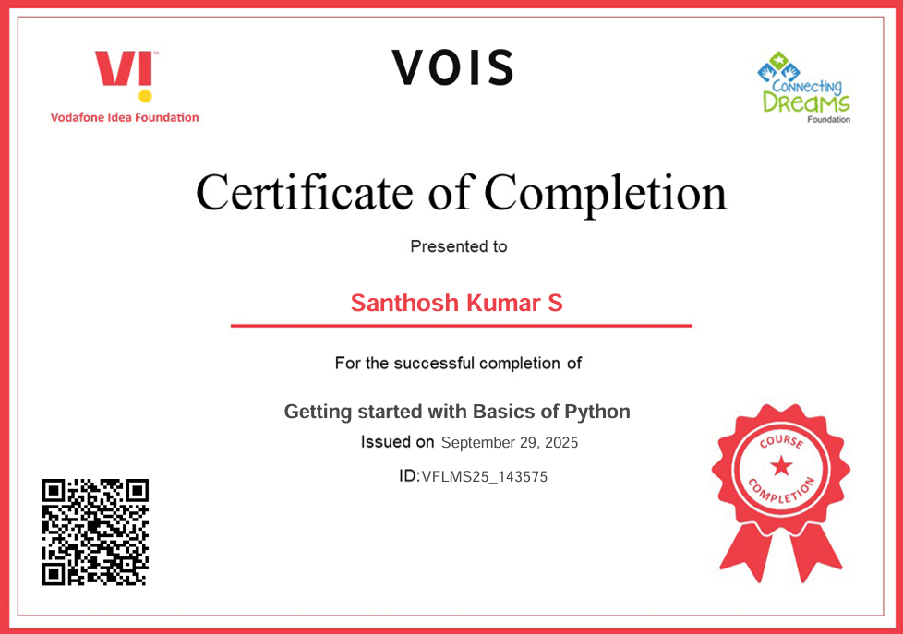
Getting started with Basics of Python Certificate

Slide 12
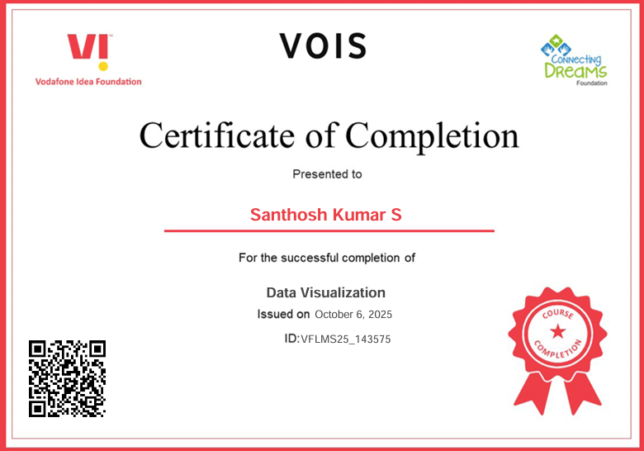
Data Visualization Certificate

Slide 13
Thank you
I sincerely thank Vodafone Idea Company and AICTE for giving me this opportunity.
Your teaching method of courses was very beautiful, it’s very nice.
.
VOIS_AICTE_OCT2025_SANTHOSH_KUMAR_S.ipynb-COLAB

